Slide 1
Basic Mechanical Engineering (BME) (Practical)
Experiment No : 1
Determination of speed ratio in a power transmission system.
Date of Experiment: 01/09/2021
We shall discuss only about the mechanical power transmission systems.
1

Slide 2
What is Power transmission mechanism?
Power is defined formally as energy per unit time. The unit of power is joule/sec or watt. The mechanism used to transport power produced at one location to some other desired location is called a power transmission system.
For example,
Transport of the power generated by the turbines to rotate the armature coil.
Transport of power generated by the engines to the wheels of a vehicle.
Transport of mechanical power imparted to the paddles of a bicycle to the rear wheels.
2

Slide 3
Important elements of power transmission system
Machine elements used for transmitting the power are called power transmitting elements. A few key elements are listed here
Shaft
Bearing
Key
Coupling
Clutch
Gear
Pulley
Belt
Chain
Sprocket
.
3

Slide 4
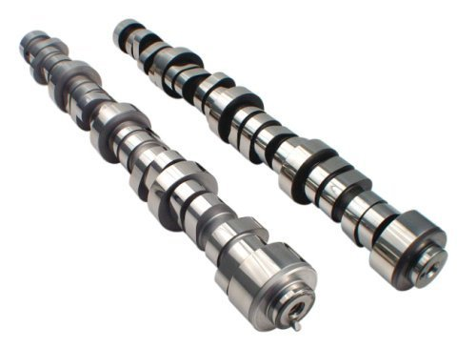
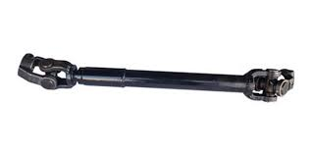
1. Shaft
Shafts are mechanical components of circular cross-sections and are used to transmit rotational motion from one place to another or to hold some other mechanical elements.
.
Propeller shaft
Cam shaft
4

Slide 5
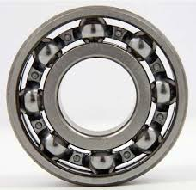
2. Bearings
In connection to transmission systems, the bearing is a machine element used to provide support and allow frictionless circular motion of the shafts.
.
Ball bearings
Shaft and bearing assembly
5

Slide 6
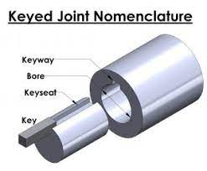
3. Key
Keys are small bars that are used to provide better fittings between shafts and shaft mountings.
.
Key shaft assembly
Application of Key
6

Slide 7
4. Coupling
Couplings are mechanical components used to connect two different shafts. Based on the alignment of the shafts, different types of couplings are used.
Various types of couplings are classified into two groups.
(1) Fixed coupling (2) Flexible coupling
Fixed couplings are used to join two coaxial or properly aligned shafts.
Sleeve coupling, Muff coupling, split Muff coupling and Flange coupling are some examples.
These coupling can not handle any kind of vibration or even a slight misalignment or skewness of the shaft axis.
Flexible couplings are used to join two non-coaxial, skewed, eccentric or intersecting shafts.
Pin and bush coupling, Oldham coupling and Universal coupling are some examples.
These coupling are designed to handle vibrations and transmission of motion and power between skewed and intersecting shafts.
7

Slide 8

Various type of couplings
Couplings maintains a speed ratio of 1:1 between the driver and driven shaft.
8

Slide 9
5. Clutch
Clutches are friction plates that help smooth power transition from the engine to the transmission system. The advantage of a clutch over coupling is that it can be easily engaged and disengaged.
Function of a clutch
9

Slide 10
6. Gears
So far, the mechanical components that we have come across can not control the speed ratio. In all previous cases, the driver and driven shafts rotated at the same speed and therefore, the speed ratio for all such cases was 1:1.
A gear is a toothed wheel that engages with another toothed wheel or a rack to change the speed or direction of transmitted motion.
Gears can be classified according to the relative positions of their shaft axes as follows:
(1) Parallel shaft gears: Spur gears, Rack and Pinion, Helical gears
(2) Intersecting shaft gears: Bevel Gears, Spiral Bevel gears, Worm gears
10

Slide 11
Parallel shaft Gears
External Spur gears
Internal Spur gears
Helical gears
11

Slide 12
Intersecting shaft Gears
Bevel gears
Spiral Bevel gears
Worm gears
12

Slide 13
Nomenclature of Gears
Pitch point and pitch circle diameter
13

Slide 14
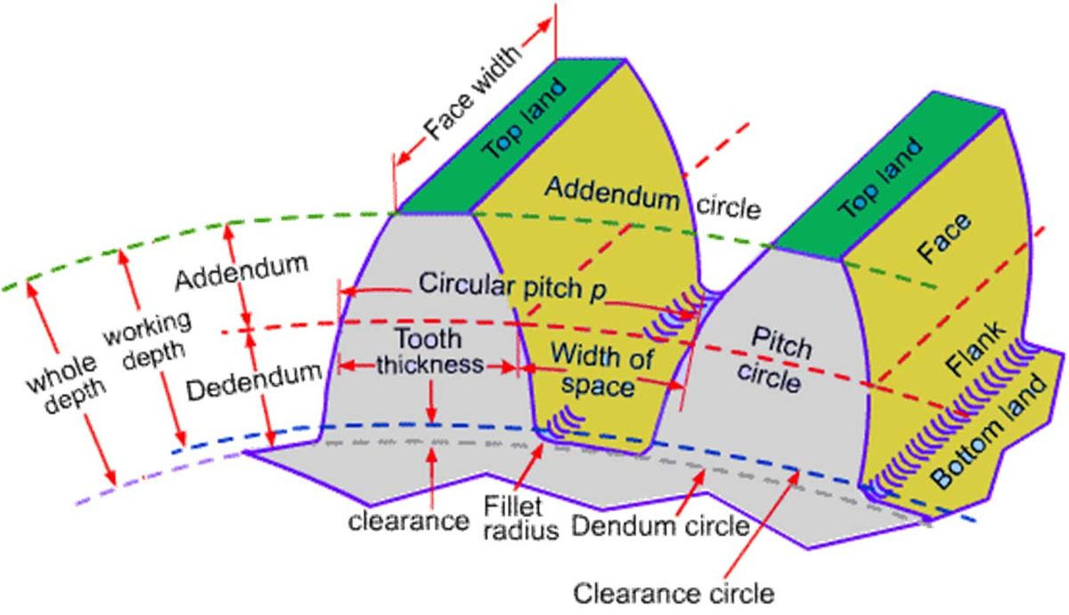
Nomenclature of Gears
Pitch circle
Addendum circle
Dedendum circle
Clearance
Whole depth
Working depth
Tooth thickness
Face width
Top land
Bottom land
Face
Flank
Circular pitch = Pi * m
Width
Module = D/T
T = Total number of teeth
14

Slide 15
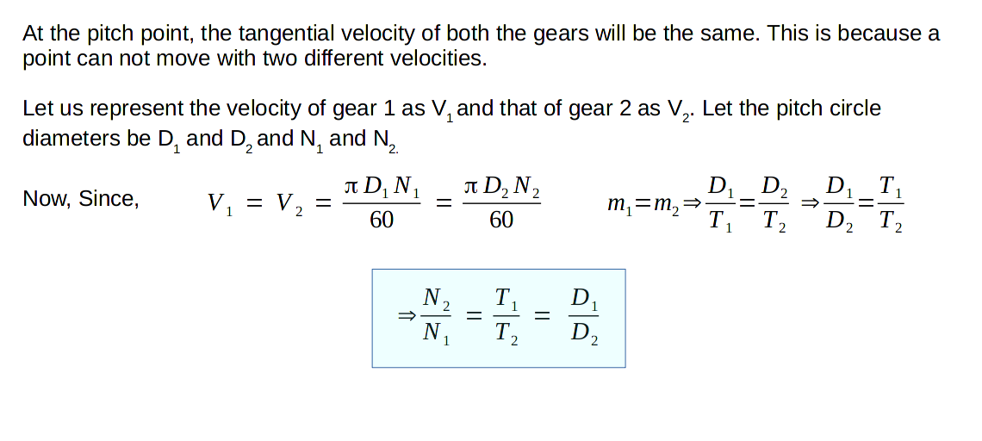
Speed ratio of Gears
15

Slide 16
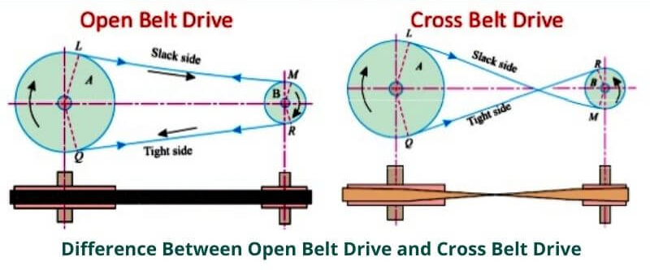
Belt Drive
In Belt drives, belts and pulley is used to connect two parallel shafts. Based on the belt and pulley configuration, this is classified as open belt drive and crossed belt drive.
16

Slide 17
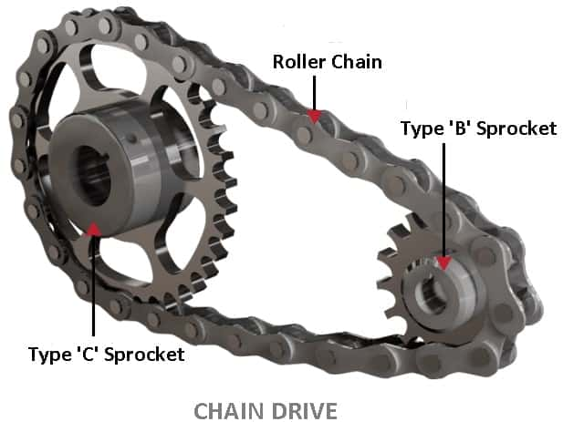
Chain Drive
Chain drives are similar to Belts drives. In the case of Chain drives, we use a chain instead of the belt.
17

